Slide 1
The Mystery of Discipline: Some ideas for a Book
Miguel Angel Centeno

Slide 2
On the way to discipline….
“They look like soldiers”
“Disicipline always wins”
“We’re here because we’re here”
“Just try acting”
“This is not about you”
“Practice makes perfect”
“لا إله إلا الله محمد رسول الله
But of all those who talk this way, none had observed it, none had endured it. Most of you here know what it means when 100 corpses lie next to each other, when 500 lie there or when 1,000 are lined up. To have endured this and at the same time to have remained a decent person - with exceptions due to human weaknesses - had made us tough. This is a page of glory never mentioned and never to be mentioned. [...]

Slide 3
Obedience, Duty, and Discipline
Need to distinguish:
Obedience is about compliance with orders, constraints.
Element of choice a la Simmel---choose to submit rather than face alternatives
Some element of cost-benefit analysis.
Key syntax: “obedience of”
Accusative case---direct object of action

Slide 4
Obedience, Duty, and Discipline
Need to distinguish:
Duty is obedience motivated by devotion to a cause.
As self-imposed obligation to live in accordance with a set of principles.
Legitimacy of principles is critical
Key syntax: “duty to”
Dative case—indirect object of action

Slide 5
Obedience, Duty, and Discipline
Need to distinguish:
Discipline is about control of behavior.
It may be motivated by a goal, but driven by itself.
It is an assertion of willpower
The point of discipline is discipline.
Key syntax: “discipline over”
Instrumental case---means by which a subject accomplishes an action

Slide 6
Discipline as Power
Obedience:
1st Dimension
Explicit and visible
Action
Duty
2nd Dimension
Explicit, but hidden
Action and belief
Discipline
3rd Dimension
Invisible
Self motivated

Slide 7
Disicipline
“ …a specific set or rules, methods, routines, drills, exercises and techniques of control that lead to the formation of individuals in specific social environments”
Oxford Encyclopedia of the Modern World
“the practice of training people to obey rules or a code of behavior…the training, indoctrination, and encouragement through reward and example of certain practices “
Oxford Companion to Military History
“A state of orderly conduct conforming to a certain standard”.
The Oxford Dictionary of Sports Science & Medicine
“training that corrects, molds or perfects the mental faculties or moral character...control gained by enforcing obedience or order…. prescribed conduct or pattern of behavior”
Merriam Webster

Slide 8
Discipline
The concept of discipline was introduced and Important for Max Weber, Norbert Elias, and Michel Foucault.
Each of these thinkers claimed that discipline is connected to the development of standards and rational structures that we either impose on ourselves or are forced to take over, and which apply in all areas of society and within our daily lives.
More recently, Gerhard Oestreich’s study of neostoicism, Philip Gorsky work on the disciplinary revolution, and social psychological work by Roy Baumeister.

Slide 9
Why study discipline?
Largely been ignored or treated normatively
In the last 2-3 decades, it has been replaced by exchange and utilitarian models.
Yet, such perspectives fail to explain a great deal of human interaction.
I want to argue that at the core of social order is a notion of discipline (but not alone).

Slide 10
Mechanisms
Repetition
Punishment
Reward
Devotion
Prayer/Meditation
Ritual

Slide 11
Normative Concerns
“it is one thing to praise discipline, and another to submit to it”.
Cervantes, Coloquio de los Perros
A claim for normative neutrality in its analysis.
May produce much good but also much evil.
Our concern is with how it is produced, not how it is used.

Slide 12
Key Tasks
Distinguish between discipline and residual variable used to explain unexpected outcomes (e.g. victory because of greater discipline).
Distinguish between social discipline and purely psychological and individual attributes.
Define and analyze mechanisms though which discipline is made.

Slide 13
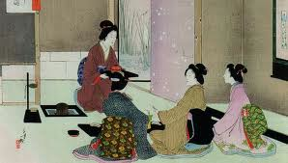
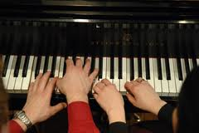
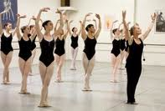
Case 1: Aesthetic Discipline
Skill development
Punish/reward
Precision
Aesthetics of control
“Again”
Simmel, Adorno

Slide 14
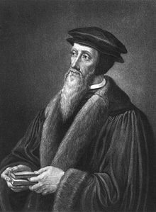
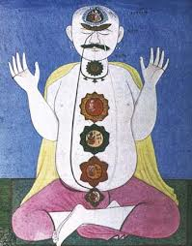
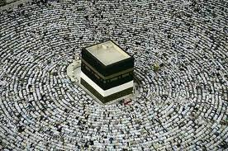
Case 2: Spiritual Discipline
Denial
Submission
Loss of id and ego
Aesthetics of asceticism
“Conquer self”
Weber

Slide 15
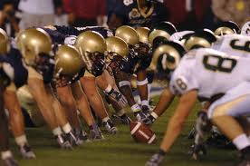
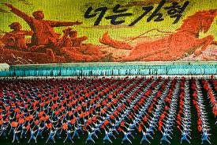
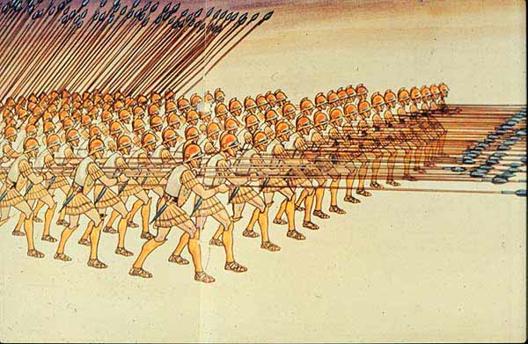
Case 3: Martial Discipline
Authority
Sacrifice
Aesthetics of Formation
Camaraderie
“Vicarious courage”
Weber, Hintze

Slide 16
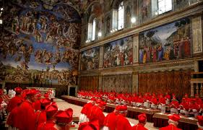
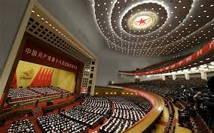
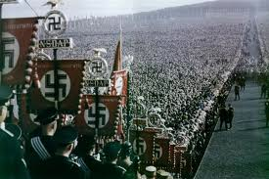
Case 4: Organizational Discipline
Hierarchy
Aesthetics of Obedience
Loyalty
Order
“Resistance is futile”
Lenin, Michels, Loyola, Weber

Slide 17
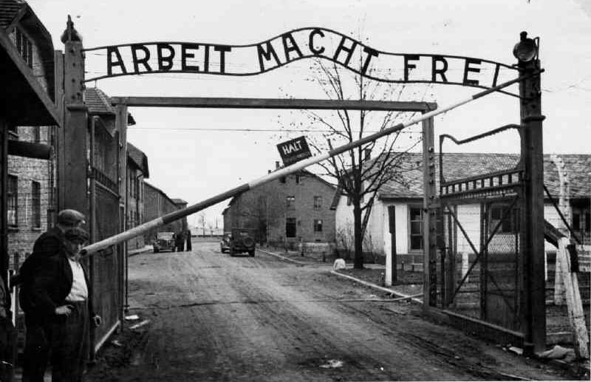
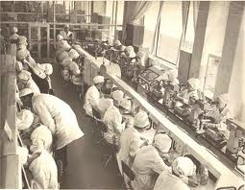
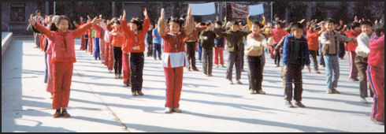
Case 5: Industrial Discipline
Linearity
Interdependence
Fordist Aesthetics
Commodification
Fungiability
“Standard uniformity”
Marx

Slide 18
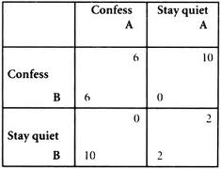
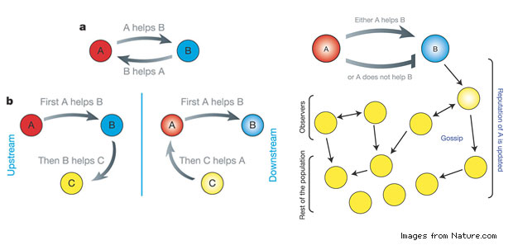
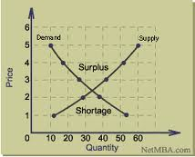
Case 6: Iterative Discipline
Reputation
Expectations
Aesthetics of Reciprocity
Empirical
Utilitarian
“Reap what you sow”
Durkheim, Liberalism

Slide 19
Conclusion
Is there a general concept behind discipline?
Coherence as dependent variable?
Coherence as independent variable?
Where is it useful?
Condition of modernity?
Can we speak of it w/o subjects?

